Slide 1
Web Development 2

Slide 2
Day 2

Slide 3
Agenda
Responsive images
Lab time

Slide 4
Images for the Web

Slide 5
Web Image Formats
Image formats supported all modern browsers
JPG (JPEG)
PNG
GIF
SVG (not supported in IE8)
Image formats with select browser support
WebP
Supported by Edge, Chrome, Firefox, Opera
Not supported by Safari

Slide 6

JPEG
Extension: jpg
Joint Photographic Experts Group
Lossy compressed format
Good quality with smaller file sizes
No easy alpha transparency channel support without some web dev tricks
Here is one solution: https://w3.eleqtriq.com/2014/08/applying-alpha-channels-to-jpgs/
Used for:
Photo realistic images

Slide 7

PNG
Extension: png
Portable Network Graphic
Lossless format
High quality
File sizes can be large if using the 24-bit version
Support for alpha transparency
Used for:
Icons
logos
Instagram logo from: https://www.freepnglogos.com/images/instagram-logo-png-2426.html

Slide 8
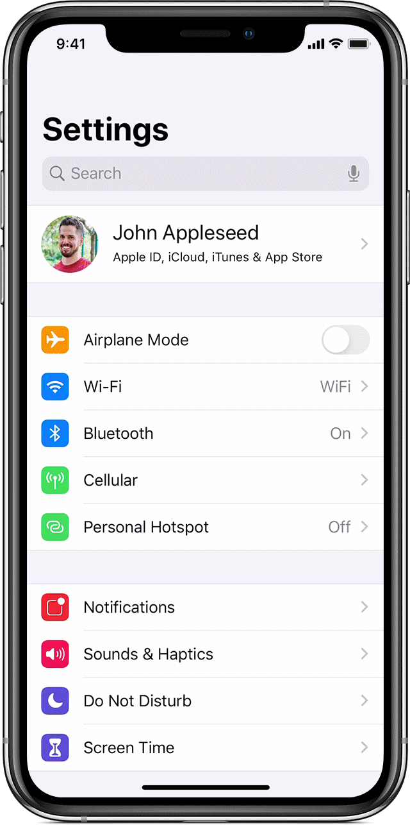
GIF
Extension: gif
Graphics Interchange Format
256 total colours chosen from a 24-bit RGB color space¹
Alpha transparency support
Animation support (animated GIFs)
Used for:
Silly internet memes
Demos and tutorials
The above image is an animated GIF. If you want to see the animated version, then either view this presentation in Slide Show mode (you must be using PowerPoint) or visit: https://support.apple.com/en-us/HT201320
1. https://en.wikipedia.org/wiki/GIF
iPhone image from: https://support.apple.com/en-us/HT201320

Slide 9
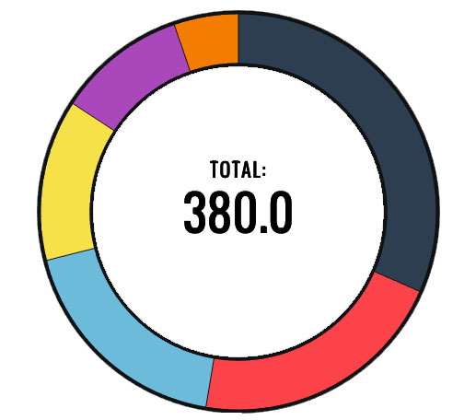
SVG
Extension: svg
Vector based image format
Vector images use math and geometry to generate graphics vs pixels (bitmapped image formats)
Scalable
No need to provide small, medium & large version for mobile responsive web sites
Interactive
SVG use a markup language similar to HTML and SVG tags can be manipulated by CSS and JS if you embed SVG code directly into the HTML page
Can be included on a web page via various methods
See this web site for details: https://www.sitepoint.com/add-svg-to-web-page/
Used for:
Infographics
Logos
Icons
Donut chart image modified from: https://codepen.io/githiro/pen/ICfFE

Slide 10

WebP
Extension: webp
Lossy and lossless support
Alpha transparency support
Animation support
Not supported in Internet Explorer
Rose image from: https://developers.google.com/speed/webp/gallery2

Slide 11

AVIF
Extension: avif
Lossy and lossless support
Alpha transparency support
Animation support
Not supported in Edge* and Internet Explorer
*AVIF support can be enabled with a flag in Edge, but only use this for testing. You should not expect your users to enable a browser flag.
Rose image from: https://developers.google.com/speed/webp/gallery2

Slide 12
Image Optimization for the Web

Slide 13
Why Optimize Your Images
Images from a camera or your smart phone are too large in both file size and image dimension terms for the web
The web is a relatively low-resolution medium
No need to serve massive images for most web sites
Serving large images slows your web site down

Slide 14
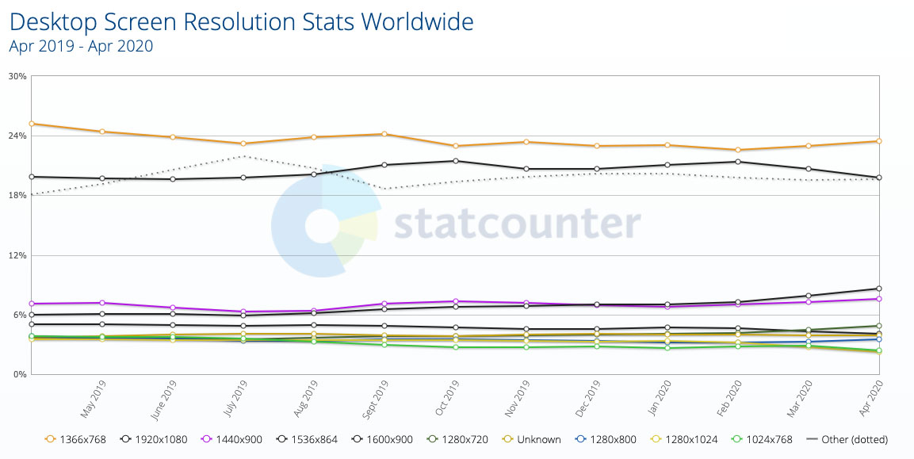
Desktop Screen Sizes
Desktop screen resolution chart from: https://gs.statcounter.com/screen-resolution-stats/desktop/worldwide

Slide 15
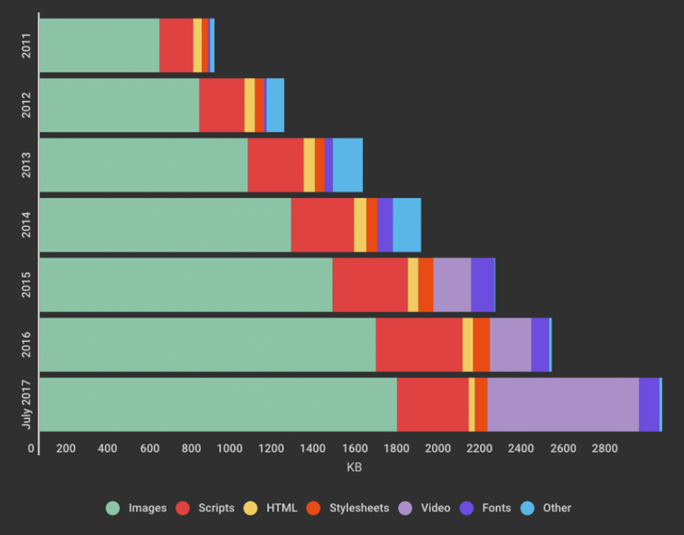
Average Web Page Weight (size in KB)
Bar graph from: https://www.speedcurve.com/blog/web-performance-page-bloat/

Slide 16
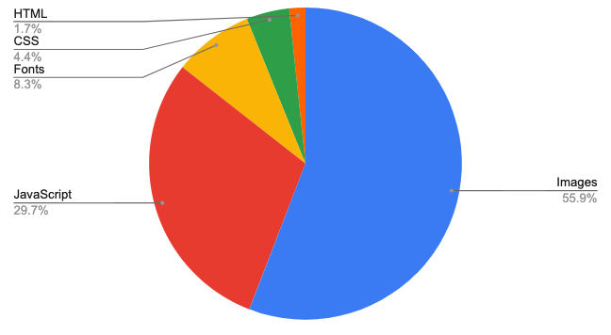
Page Weight by Resource Type
Pie chat from: https://www.debugbear.com/blog/page-weight-website-speed

Slide 17
What Does My Site Cost
Larger web page weights equals potentially higher server costs for you and potentially higher bandwidth costs for both you and your users

Slide 18
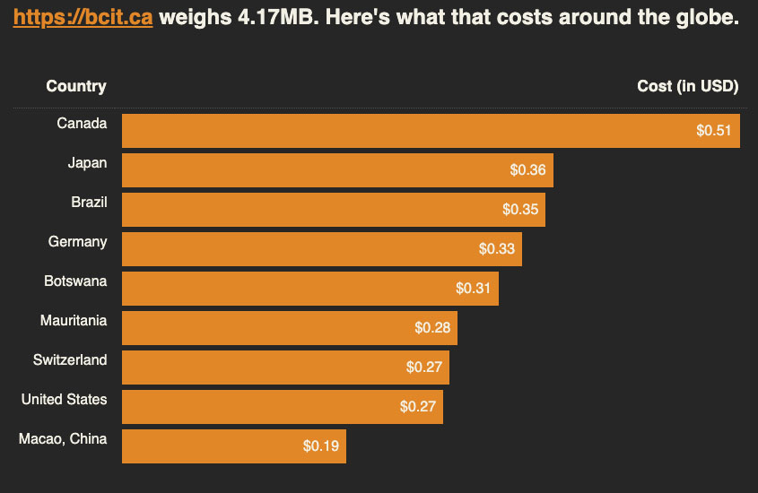
What Does My Site Cost
Webpage cost chart for BCIT’s website homepage from: https://whatdoesmysitecost.com

Slide 19
Image Sizes (w x h) Rough Guide
Image sizes for web pages will change depending on the following criteria:
Design
User devices
User bandwidth
No single file size will work on all web pages, it really depends on each individual web page’s requirements
With that said, the next slide will give you some rough starting points for images sizes for common images found on the web

Slide 20

Image Sizes (w x h) Rough Guide
Logo images can be roughly sized to between 100 – 400 pixels in width
Full bleed banner images can be roughly resized to between 1500 – 2500 pixels in width
Thumbnail images can be roughly sized to between 200 – 800 pixels in width
UBC Web page screen shot from: https://www.ubc.ca/

Slide 21
Image Editing Software

Slide 22
Image Editing Desktop Software
Photoshop
Industry standard image editor
Lots of powerful tools than can speed up image editing
Costs money
GIMP
Free software
Provides most of the tools that a web developer would need to do simple image edits
Interface can be difficult to use
Try GIMPShop – a Photoshop UI skin for GIMP

Slide 23
Vector Image Editing Desktop Software
Illustrator
Industry standard vector image editor
Lots of powerful tools than can speed up vector image editing
Costs money
Inkscape
Free software

Slide 24
Browser Based Online Image Editors
Photopea ( https://www.photopea.com/ )
Vectr (https://vectr.com/ )
Vector image editor

Slide 25
Responsive Images

Slide 26
Setting Max Width for All Images
Most mobile responsive web sites have a fluid design
With fluid widths, no one image size will work
By default images expand beyond their containers if their natural width is wider than their container
To prevent this behavior, set a “max-width” CSS property to “100%” on the image
Since this is so useful in responsive web development, we usually just set this on all images at the top of a stylesheet

Slide 27
Responsive Images – Max Width Reset
img {
max-width: 100%;
height: auto;
}

Slide 28
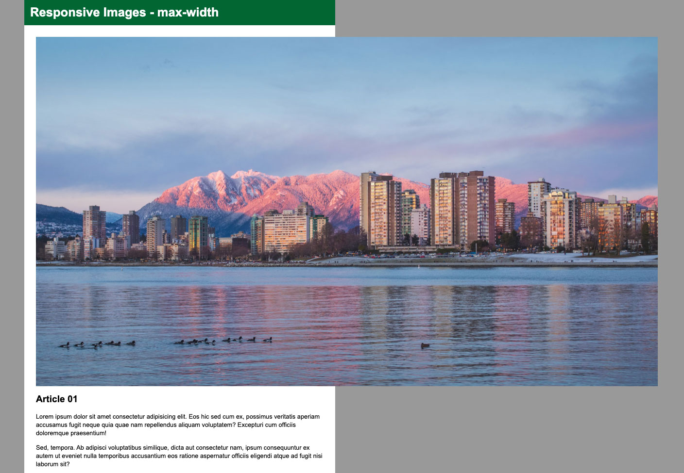
Max Width Not Set
By default images will expand beyond their parent container if they are too large to fit inside their parents container
Parent container width

Slide 29
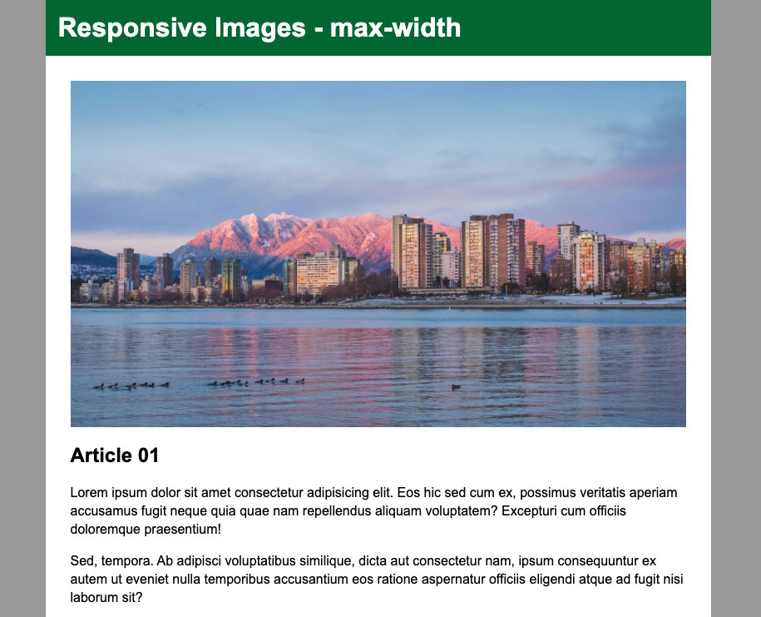
Max Width Set
Image stays within the width of its container element because a CSS property value pair of “max-width: 100%” was set on the image
img {
max-width: 100%;
height: auto;
}
Parent container width

Slide 30
Responsive Images
Responsive web design is fantastic as it allows web developers to write one set of HTML/CSS and JS and serve it for all devices or various sizes from large desktops down to small mobile devices
This creates a problem for images however as you could end up in a situation where you are serving a large banner image meant for desktop screens to a tiny mobile phone device
Responsive images specification solves this by allowing your web page to serve different sized images to different devices

Slide 31
Srcset, Sizes and Picture
The responsive images spec provides a few ways to code mobile friendly images
Each method has its own use case

Slide 32
Srcset & Sizes
Srcset & Sizes are new attributes for the standard image tag (<img>)
Srcset & Sizes can also be used on the “source” tag within the picture (<picture>) element
Srcset & Sizes provide additional information to the browser to help the browser choose the optimal image for the current device

Slide 33
Srcset & Sizes
The chart on the next slide shows all information that the browser needs to choose the correct image
Note how the browser only knows half information to serve the optimal image
Srcset & Sizes is designed to give the browser the missing information that it need to serve the optimal image

Slide 34
Srcset & Sizes
Variables Needed to Serve the Optimal Image | Known by the Web Developer | Known by the Browser when Loading the Page
Viewport dimensions | No | Yes
Image size relative to the viewport | Yes | No
Screen density | No | Yes
Source files’ dimensions | Yes | No
Chart modified from: https://ericportis.com/posts/2014/srcset-sizes/

Slide 35
Srcset & Sizes
Variables Needed to Serve the Optimal Image | Known by the Web Developer | Known by the Browser when Loading the Page
Viewport dimensions | No | Yes
Image size relative to the viewport | Yes | No Yes, via sizes
Screen density | No | Yes
Source files’ dimensions | Yes | No Yes, via srcset
Chart modified from: https://ericportis.com/posts/2014/srcset-sizes/

Slide 36
Srcset & Sizes Syntax
Srcset provides the browser with a list of images to choose from. The width descriptors (2400w) beside each image tell the browser how wide an image is in pixels using the “w” value.
IMPORTANT: The widths listed in the srcset attribute are not made up values. They must equal the true width of the image in pixels. You can find out the width of an image by getting info about the image file from your operating system.
DO NOT MAKE THESE NUMBERS UP!!!
<img src="images/city-large.jpg"
alt="Vancouver"
srcset="images/city-retina.jpg 2400w,
images/city-large.jpg 1200w,
images/city-medium.jpg 800w,
images/city-small.jpg 400w"
sizes="(max-width: 1260px) calc(100vw - 60px), 1200px">
Sizes gives the browser information about how much width an image will take up relative to the browser width at various screen sizes

Slide 37
WARNING!!!
DO NOT MAKE UP IMAGE WIDTHS
WHEN USING SRCSET!!!!!!!
WARNING!!!

Slide 38
Testing Srcset & Sizes
Be aware that Chrome will not load smaller images if the larger image has already loaded
This can be frustrating if you are testing your responsive images code
To get around this, you can resize your web site down, clear the cache and re-fresh the browser, or do a hard re-fresh (CTRL+F5 on Windows and CMD+SHIFT+R on Mac) after you re-size your browser down to mobile screen sizes
Firefox will load smaller images regardless…So it is a bit easier to test your srcset and sizes code in Firefox

Slide 39
Picture Element
The picture element is an HTML element
Allows you to serve different images at specified browser sizes via a source element with a media attribute
Used for:
Art directing images
Serving different crops of the same image to different devices
Not serving an image at certain screen sizes
Provide image fallbacks to browsers that do not support certain modern image formats

Slide 40
Picture Element Syntax
<picture>
<source srcset="images/vancouver-skyline-winter-retina.jpg 1600w,
images/vancouver-skyline-winter-large.jpg 801w"
sizes="(max-width: 960px) calc(100vw - 40px), 920px"
media="(max-width: 600px)">
<img src="images/vancouver-skyline-winter-wide-large.jpg"
srcset="images/vancouver-skyline-winter-wide-large.jpg 1246w,
images/vancouver-skyline-winter-wide-small.jpg 624w"
sizes="calc(100vw - 40px)"
alt="Vancouver winter skyline">
</picture>

Slide 41
Picture Element Syntax
Source element tells the browser to load a certain image at a certain screen width. The media attribute tells the browser when to load the image listed in the srcset attribute.
You can have more than one source element.
<picture>
<source srcset="images/vancouver-skyline-winter-retina.jpg 1600w,
images/vancouver-skyline-winter-large.jpg 801w"
sizes="(max-width: 960px) calc(100vw - 40px), 920px"
media="(max-width: 600px)">
<img src="images/vancouver-skyline-winter-wide-large.jpg"
srcset="images/vancouver-skyline-winter-wide-large.jpg 1246w,
images/vancouver-skyline-winter-wide-small.jpg 624w"
sizes="calc(100vw - 40px)"
alt="Vancouver winter skyline">
</picture>

Slide 42
Picture Element Syntax
<picture>
<source srcset="images/vancouver-skyline-winter-retina.jpg 1600w,
images/vancouver-skyline-winter-large.jpg 801w"
sizes="(max-width: 960px) calc(100vw - 40px), 920px"
media="(max-width: 600px)">
<img src="images/vancouver-skyline-winter-wide-large.jpg"
srcset="images/vancouver-skyline-winter-wide-large.jpg 1246w,
images/vancouver-skyline-winter-wide-small.jpg 624w"
sizes="calc(100vw - 40px)"
alt="Vancouver winter skyline">
</picture>
The “img” element will load if none of the source elements media conditions match.
The “img” element is also used as a fallback for older browsers that do not support the picture element.

Slide 43
Images and Copyright
I am not a lawyer. The advice on the next two slides constitutes only my everyday man opinion on the rules of copyright in Canada
If you want to be 100% sure about the use of an image or other media, then ask for professional legal advice from a lawyer or stick with images and media in the public domain, pay for the license to use an image or use images and media that you create

Slide 44
Images and Copyright
Most images created in the past 100 years are covered by copyright by default unless the creator explicitly put them in the public domain
In Canada the general rule is, a work (in this case graphics and images) falls into the public domain 50 years after the death of its creator
Older imagery, drawings/photographs from the 19th, 18th etc… centuries are probably in the public domain and are generally free to use
For school projects you can use most images that are freely available on the web (not behind a paywall) as long as the use of the images or graphics are for educational purposes and are not widely distributed and you provide attribution to the source or creator of the work
For client work or commercial work you must have permission to use a graphic or image from another creator on most commercial web sites, unless the graphic or image is in the public domain

Slide 45
Where to Get Free Images Legally
Unsplash ( https://unsplash.com/ )
Consists of photos donated by photographers for use by others
Pixabay (https://pixabay.com/ )
CC Search ( https://ccsearch.creativecommons.org/ )
Searches the web for images that are creative commons licensed
Some CC licenses will require you to provide attribution
Some CC license do not permit uses in commercial projects
Google Images with a filter by license
Click on “Tools” and then “Usage Rights” and select a usage you need
Always double check the usage rights to be sure
Wikimedia Commons (https://commons.wikimedia.org/wiki/Main_Page )
Double check the image license before using

Slide 46
Purchasing Stock Images
Purchasing licenses to stock images is an inexpensive way to get legal high-quality images for a commercial web site
No need to purchase images for school projects. This list is provided for those that wish to do web development work professionally
Stock image web sites:
iStock ( https://www.istockphoto.com/ca )
Adobe Stock* ( https://stock.adobe.com/ca/ )
*You may have access to this resource as part of your BCIT Adobe CC subscription
Storyblocks ( https://www.storyblocks.com/ )

